Slide 1
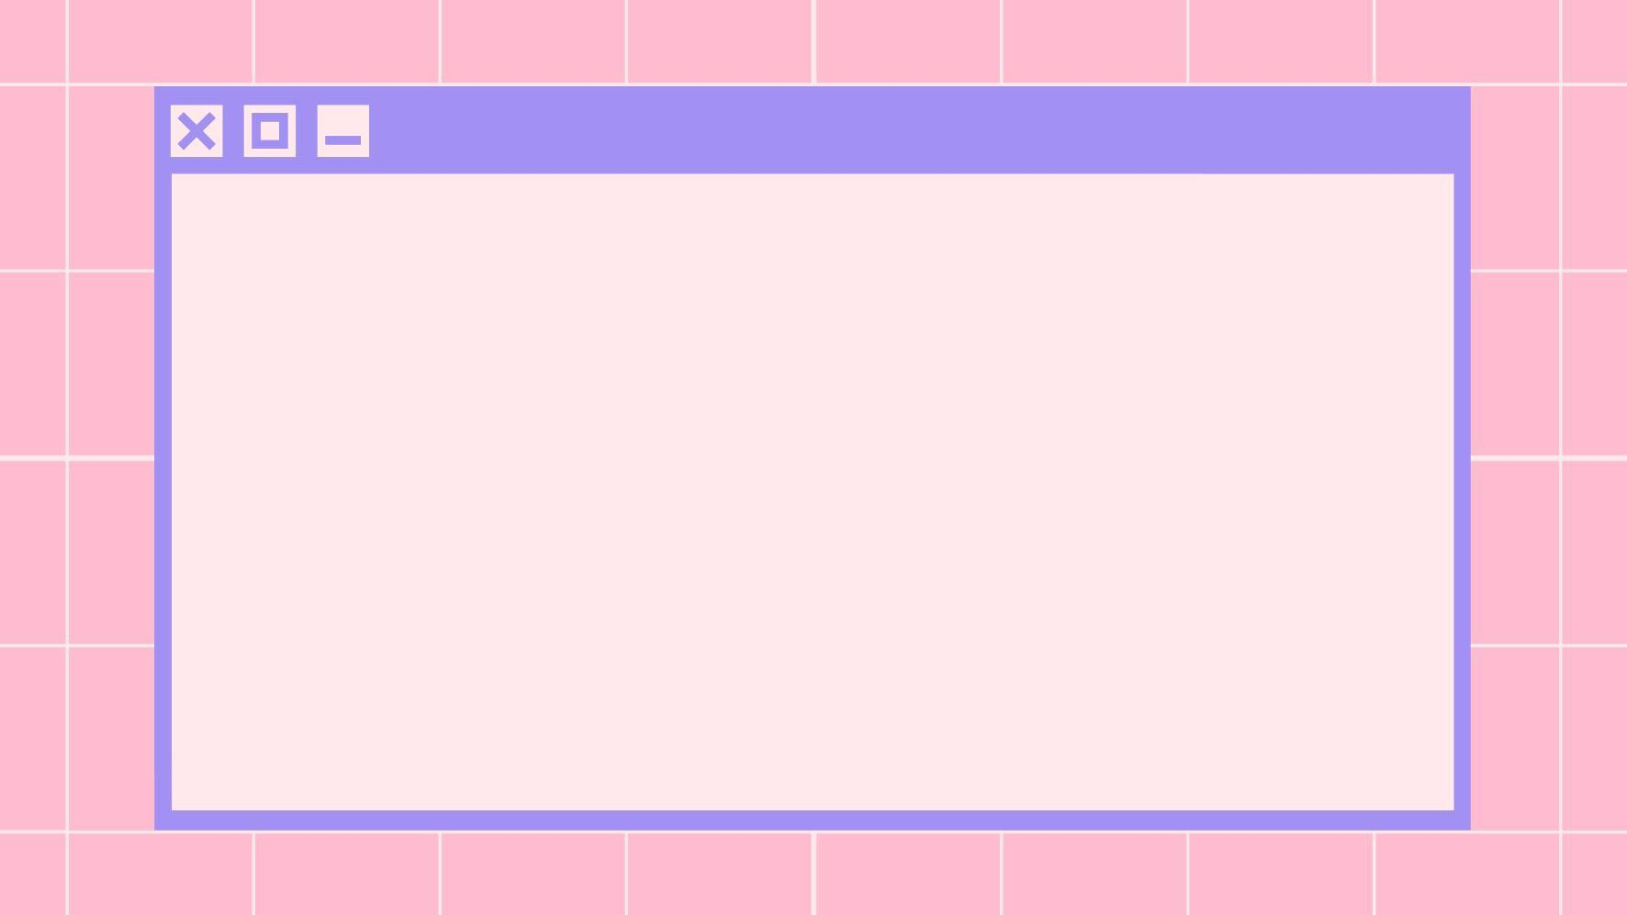

Clumsy Guppy Studios present:
Isabelle Cordova + Diana Kumykova

Slide 2
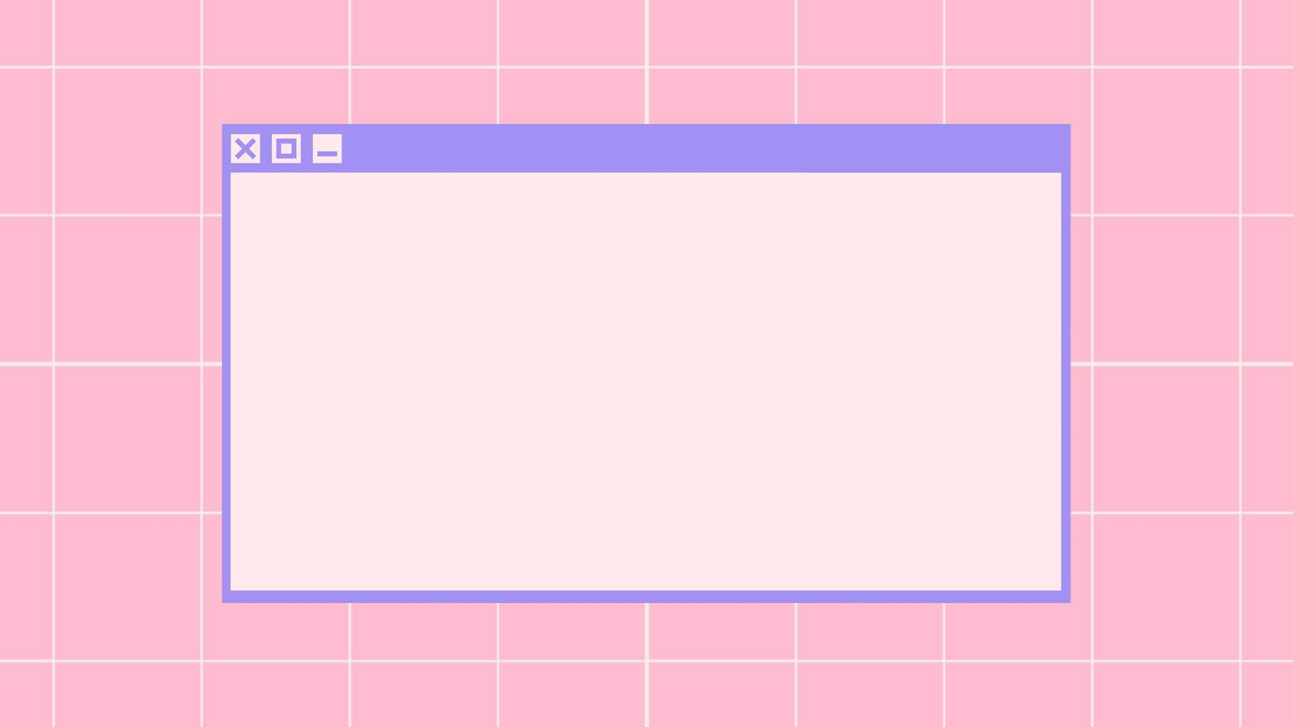
Logline
Raise your own little pathogen!
Let’s go
Notes:
Coronagotchi allows players to live out the nostalgia of older handheld games while either helping or harming their little Corona pet in this dark humor twist on the classic Tamagotchi.

Slide 3
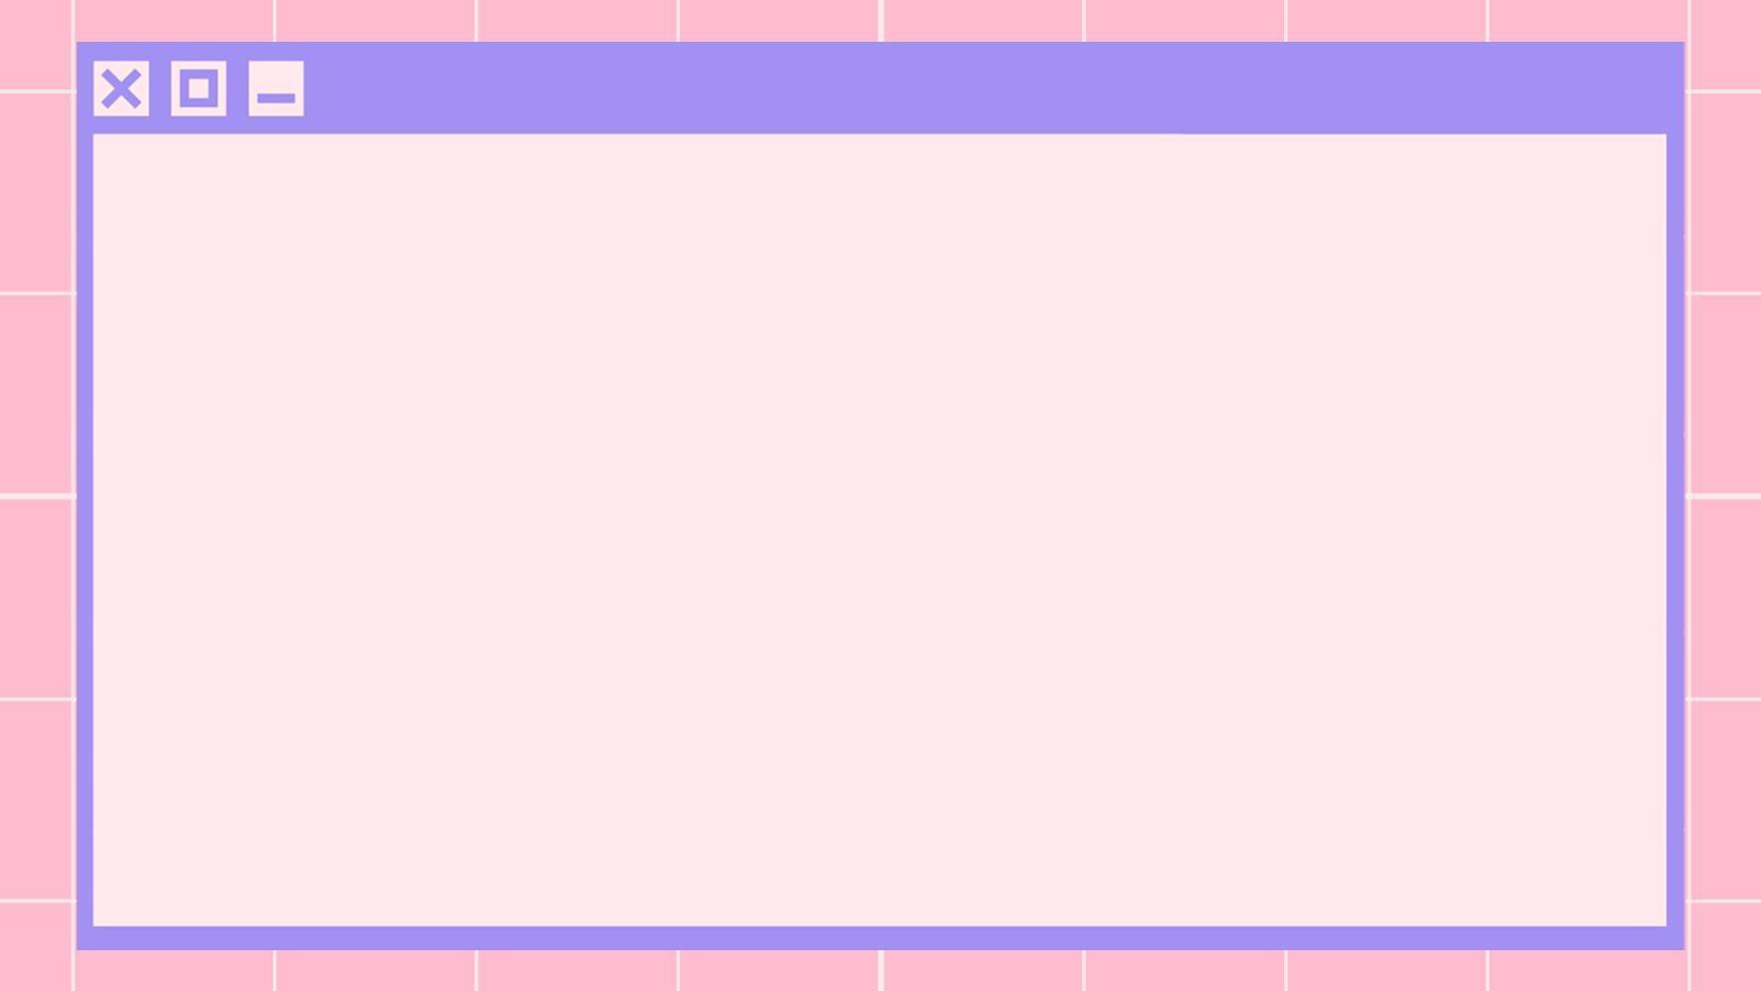
Game Description
Coronagotchi allows players to live out the nostalgia of older handheld games while either helping or harming their little coronavirus pet in this dark humor twist on the classic Tamagotchi device.

Slide 4
Essential Features
Feed, play with, and care for your virus
Dress your virus in fun costumes
Watch your virus grow from a speck to a fully grown havoc machine!
Or, if you so choose, kill it

Slide 5
How Coronagotchi Will Work
Each player starts the game with a baby virus that they can feed, nurture,and play with until they have their own cute fully grown pathogen! Players will be able to play fun mouse-controlled mini-games such as:
Moving their Coronagotchi around to catch food while avoiding fake food like vaccines
Dress their Coronagotchi in the latest viral fashion trends
Other fun activities (which we have yet to think of a complete list).
Fetch? Puzzle? Kill with fire? The possibilities are endless!
Once your Coronagotchi is all grown up and ready to face the world, you can make the choice whether or not to let it go, or kill it and start over!

Slide 6
Artist Statement
Our creation is meant to provide comedic relief from the Covid-19 pandemic by putting a dark spin on a classic game. We hope to provide an escape from the madness through nostalgia and a heavy dose of irony.

Slide 7
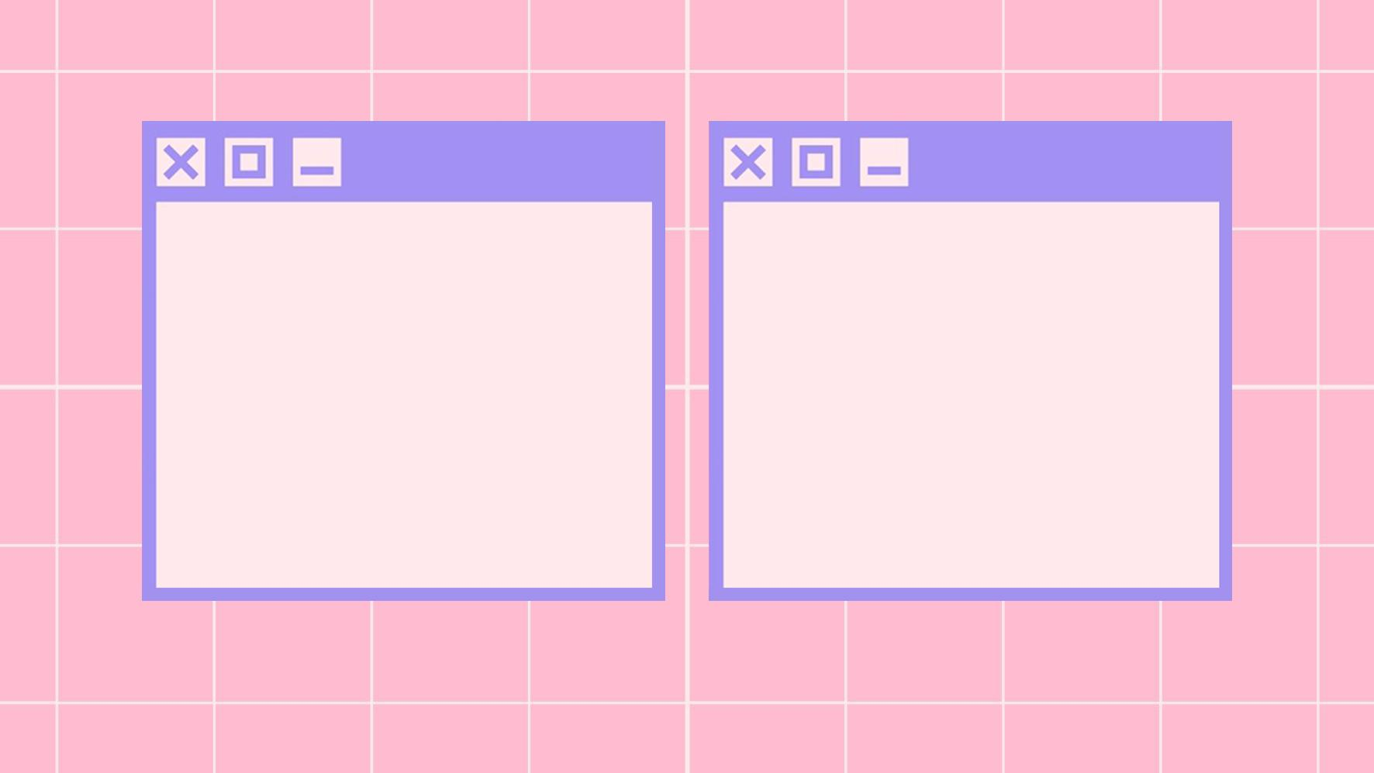
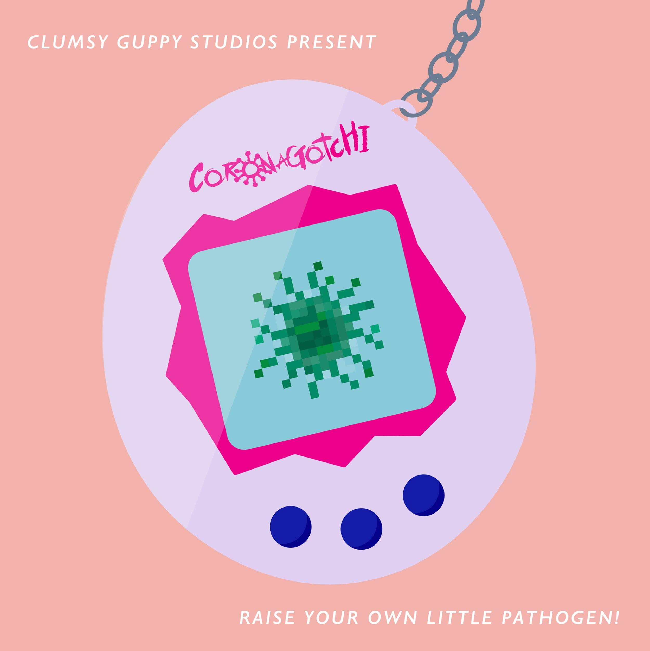
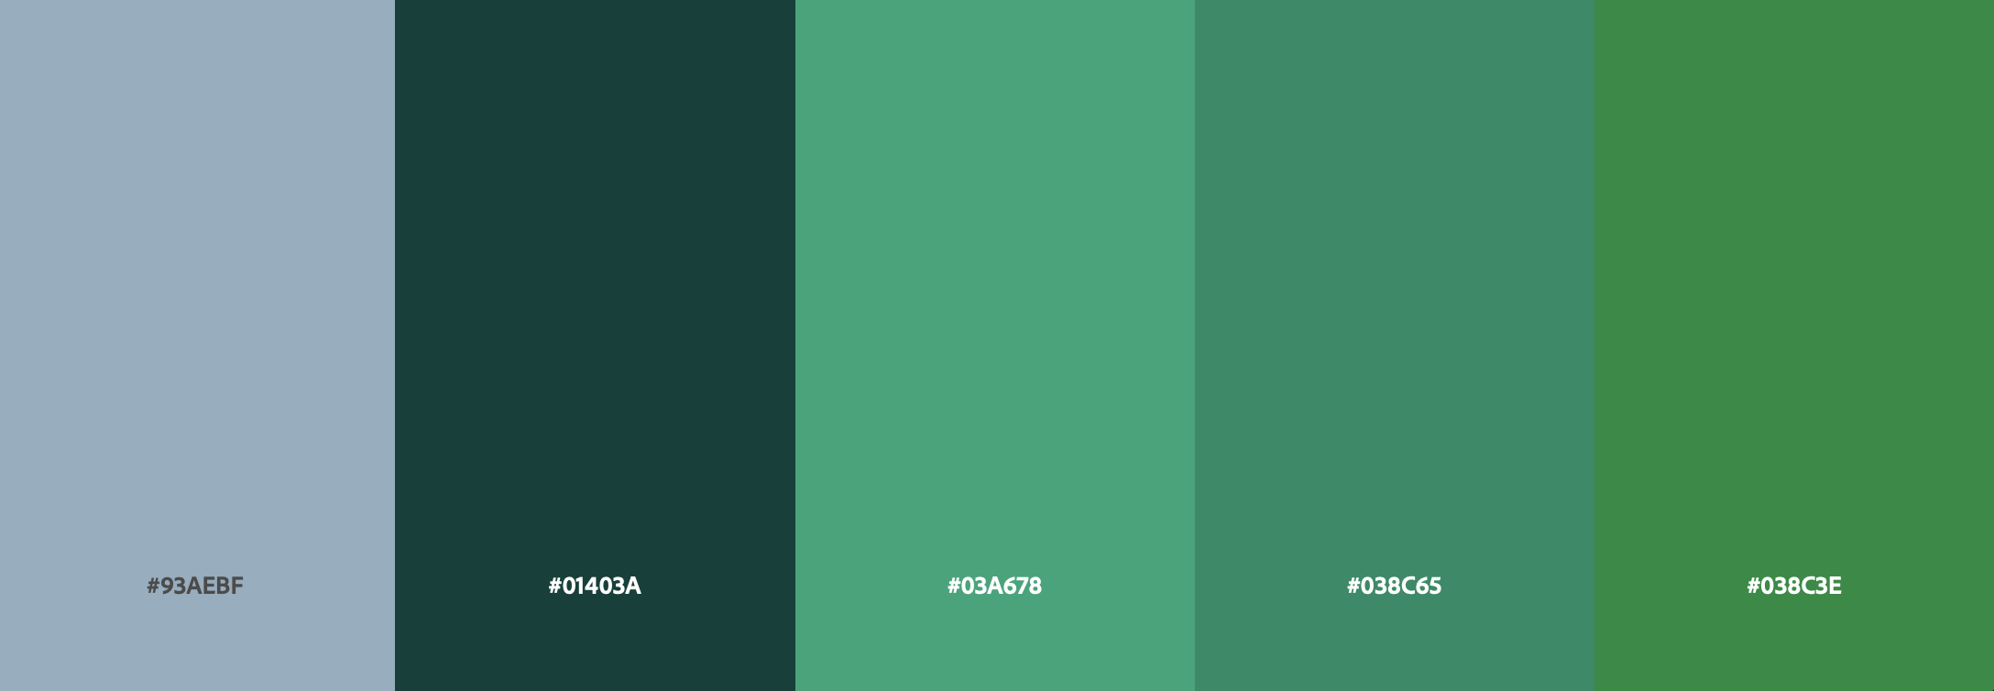
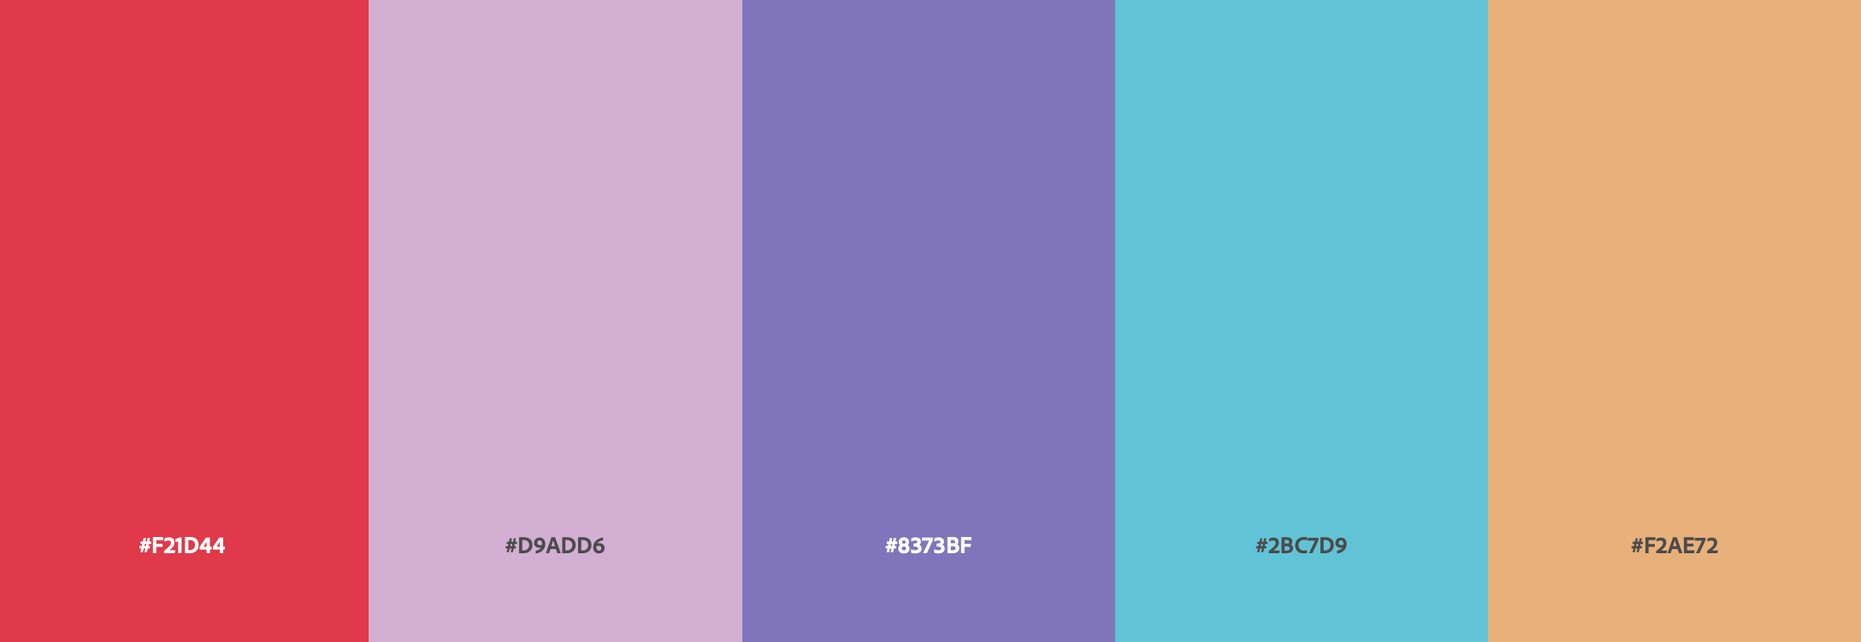
Cover Image
Color Scheme

Slide 8
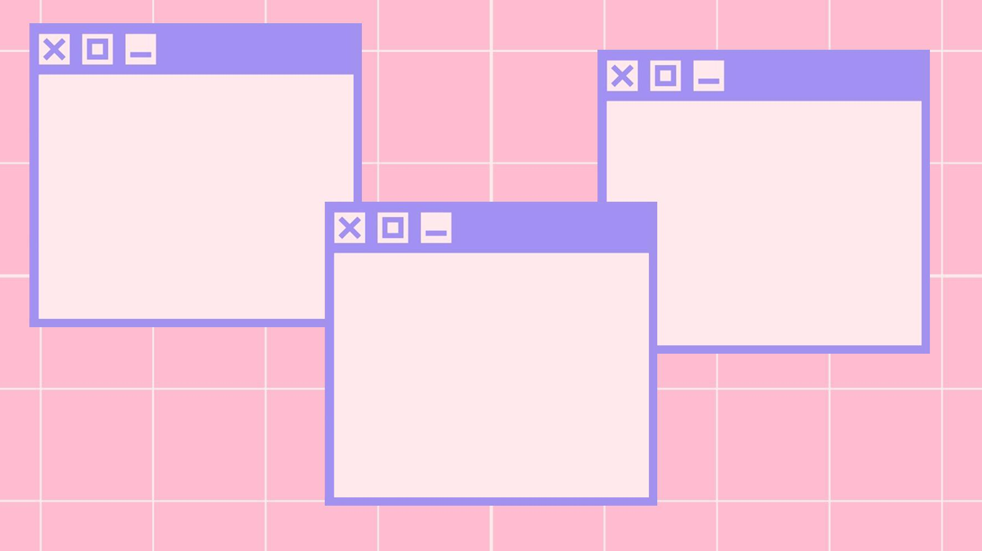



Corona-1
Corona-3
Corona-2
Concept sprite progression
(not to scale)

Slide 9
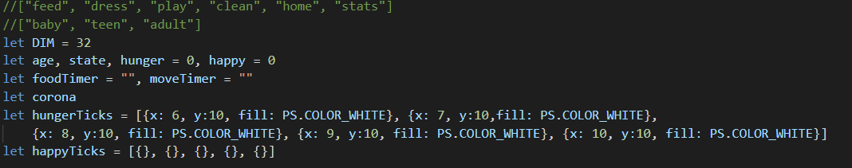
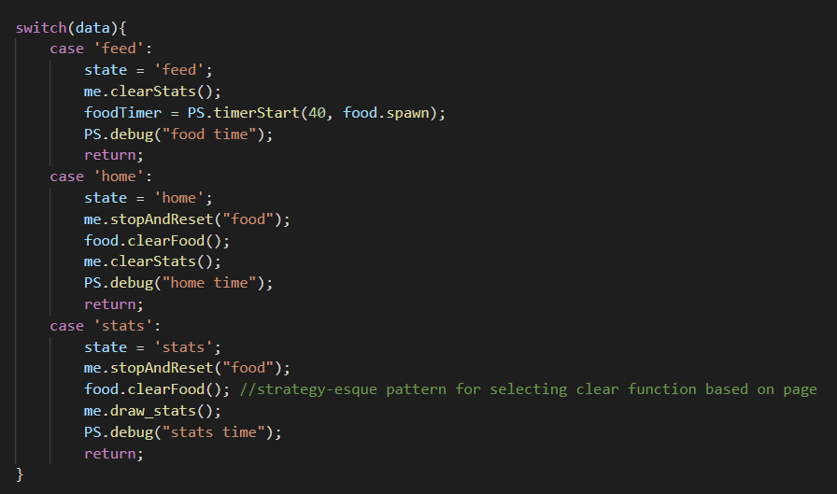
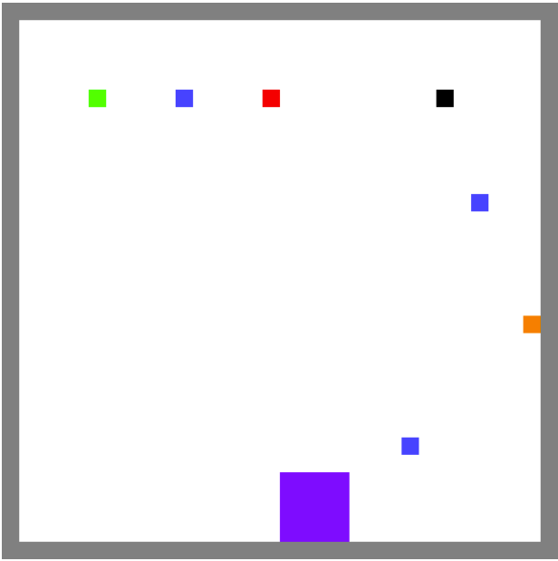
sampleCode.txt
View full sample at: https://tinyurl.com/coronagotchi
Variables to keep track of current age, state (which page player is on), and health stats such as hunger and happiness
Example state switching based off of button clicks
Example food catching game: blue are food placeholders, while orange are vaccine placeholders; colors at top represent page buttons

